Slide 1
Lecture 4 – Video and Animation
Basic Video concept
Representation and Format
Television
Basic Concept of animation
Types of Animation
Principles of Animation
Techniques of Animation
Creating Animation
Animation language
Control and Transmission

Slide 2
Basic Video Concepts
Human eye views video
immanent properties of the eye determine essential conditions related to video systems.
Video signal representation consists of 3 aspects:
Visual Representation
objective is to offer the viewer a sense of presence in the scene and of participation in the events portrayed.
Transmission
Video signals are transmitted to the receiver through a single television channel
Digitalization
analog to digital conversion, sampling of gray(color) level, quantization.

Slide 3
Visual Representation
The televised image should convey the spatial and temporal content of the scene
Vertical detail and viewing distance
Aspect ratio: ratio of picture width and height (4/3 = 1.33 is the conventional aspect ratio).
Viewing angle = viewing distance/picture height
Horizontal detail and picture width
Picture width (conventional TV service ) - 4/3 * picture height
Total detail content of the image
Number of pixels presented separately in the picture height = vertical resolution
Number of pixels in the picture width
= vertical resolution*aspect ratio
product equals total number of picture elements in the image.

Slide 4
Visual Representation
Perception of Depth
In natural vision, this is determined by angular separation of images received by the two eyes of the viewer
In the flat image of TV, focal length of lenses and changes in depth of focus in a camera influence depth perception.
Luminance and Chrominance
Color-vision - achieved through 3 signals, proportional to the relative intensities of RED, GREEN and BLUE.
Color encoding during transmission uses one LUMINANCE (the component of a television signal which carries information on the brightness of the image)and two CHROMINANCE signals(the colorimetric difference between a given colour in a television picture and a standard colour of equal luminance.)
Temporal Aspect of Resolution
Motion resolution is a rapid succession of slightly different frames. For visual reality, repetition rate must be high enough (a) to guarantee smooth motion and (b) persistance of vision extends over interval between flashes(light cutoff b/w frames).

Slide 5
Visual Representation
Continuity of motion
Motion continuity is achieved at a minimal 15 frames per second; is good at 30 frames/sec; some technologies allow 60 frames/sec.
NTSC standard provides 30 frames/sec - 29.97 Hz repetition rate.
PAL standard provides 25 frames/sec with 25Hz repetition rate.
Flicker effect
Flicker effect is a periodic fluctuation of brightness perception. To avoid this effect, we need 50 refresh cycles/sec. Display devices have a display refresh buffer for this.
Temporal aspect of video bandwidth
depends on rate of the visual system to scan pixels and on human eye scanning capabilities.

Slide 6
Transmission (NTSC)
Video bandwidth is computed as follows
350 pixels per line X 525 lines per picture X 30 pictures per second
Visible number of lines is 480.
Intermediate delay between frames is
1000ms/30fps = 33.3ms
Display time per line is
33.3ms/525 lines = 63.4 microseconds
The transmitted signal is a composite signal
consists of 4.2Mhz for the basic signal and 5Mhz for the color, intensity and synchronization information.

Slide 7
Color Encoding
A camera creates three signals
RGB (red, green and blue)
For transmission of the visual signal, we use three signals
1 luminance (brightness-basic signal) and 2 chrominance (color signals).
In NTSC, luminance and chrominance are interleaved
Goal at receiver
separate luminance from chrominance components
avoid interference between them prior to recovery of primary color signals for display.

Slide 8
Color Encoding
RGB signal - for separate signal coding
consists of 3 separate signals for red, green and blue colors. Other colors are coded as a combination of primary color. (R+G+B = 1) --> neutral white color.
YUV Signal(Through a process called "color space conversion," the video camera converts the RGB data captured by its sensors into either composite analog signals (YUV))
separate brightness (luminance) component Y and
color information (2 chrominance signals U and V)
Y = 0.3R + 0.59G + 0.11B
U = (B-Y) * 0.493
V = (R-Y) * 0.877
Resolution of the luminance component is more important than U,V
Coding ratio of Y, U, V is 4:2:2

Slide 9
Color Encoding Cont…
YIQ signal(YIQ is the color space used by the NTSC color TV system, employed mainly in North and Central America, and Japan.)
similar to YUV - used by NTSC format
Y = 0.3R + 0.59G + 0.11B
I = 0.60R - 0.28G + 0.32 B
Q = 0.21R -0.52g + 0.31B
Composite signal
All information is composed into one signal
To decode, need modulation methods for eliminating interference b/w luminance and chrominance components.

Slide 10
Digitization
Refers to sampling the gray/color level in the picture at MXN array of points.
Once points are sampled, they are quantized into pixels
sampled value is mapped into an integer
quantization level is dependent on number of bits used to represent resulting integer, e.g. 8 bits per pixel or 24 bits per pixel.
Need to create motion when digitizing video
digitize pictures in time
obtain sequence of digital images per second to approximate analog motion video.

Slide 11
Computer Video Format
Computer video format depends on the input and output devices for the motion video medium
Current video digitizers differ in digital image resolution, quantization and frame rate
Most often used display is raster display
Video Digitizer
A/D converter

Slide 12
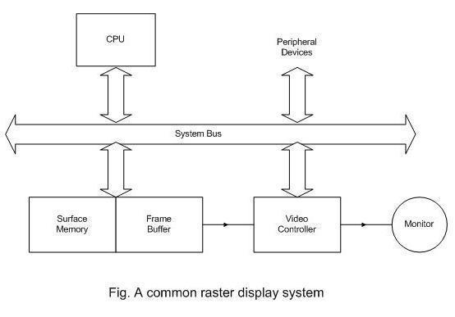
Computer Video Format Cont…

Slide 13
Computer Video Format Cont…
Some video controller standard are:
Color Graphics Array(CGA)
Resolution: 320*200
Color depth: 2 bits/pixel
Image size: 16 KB
Enhanced Graphics Array(EGA)
Resolution: 640*350
Color depth: 4 bits/pixel
Image size: 112 KB
Video Graphics Array(VGA)
Resolution: 649*480
Color depth: 8 bits/pixel
Image size: 307.2 KB
eXtended Graphics Array(XGA)
Resolution: 640*480 / 1024*768
Color depth: 65,000 colors / 256 colors
Super VGA(SVGA)
Resolution: 1024*768
Color depth: 24 bits/pixel
Image size: 2.35 MB

Slide 14
Television
It is the most important application that has driven the development of motion video.
There have many significant changes that have occurred from conventional systems used in black and white and color television, to enhanced television systems.

Slide 15
Conventional Systems
Conventional television systems employ the following standards.
NTSC (National television systems committee)
It is developed in the US and is the most oldest and widely used television standard.
A picture consists of 525 lines.
SECAM (SEquential Couleur Avec Memorie)
It is a standard used in France and Eastern Europe.
It is based on frequency modulation and a picture has 625 lines
PAL (Phase Alternating Line)
It is used in parts of Western Europe. It has the same modulation technique similar to NTSC. (quadrature amplitude modulation) And 625 lines

Slide 16
HDTV (High Definition Televisions)
Resolution:
It has app. twice as many horizontal and vertical pixels as conventional systems
The increased vertical definition is achieved by employing more than 1000 lines in a scanning patterns
The increased luminance detail in the image is achieved by employing a video bandwidth approximately five times than in conventional systems.
Aspect Ratio
The aspect ratio of the proposed HDTV image is 16/9 = 1.777
Viewing Distance
Since the eyes ability to distinguish detail is limited, the more detailed HDTV image should be viewed closer than in customary with conventional systems.

Slide 17
Transmission
In multimedia systems, the data rates created by motion video is important.
US (HDTV) image we assume 720,000 total pixels per frame.
To compute the data rate for HDTV motion video, we need further parameters such as the number of bits/ pixel and the frames/second.
If the quantization is approximately 24 bits / pixel and the frame rate is app 60 frames/second then the data rate for HDTV will be 1.296 x 108 bytes /sec
Using compression method, data rate can be lowered 34 Mbits/sec without noticeable quality loss

Slide 18
Computer Based Animation
Animation is the process of making something look and feel live
Animation is the creation of the “illusion of movement” using a series of still images
Animation can broadly be categorized into two categories
Motion Dynamics
Induction of life by changing the position of the object
Ex: animation of a bouncing ball
Update Dynamics
Induction of life by changing the shape, size and/or structure of the object
Ex: animation of flower blooming from bud

Slide 19
Computer Based Animation Cont…
Computer based animation used computer based graphical tools to provide visual effects
Advantage of computer based animation include efficiency, time and simplicity
Fundamental processes involved in animation are:
Input Process
Includes digitization of images
This can be done by using optical scanning, tracing the drawing with data tablets or producing drawing using drawing and painting tools
Composition Process
Foreground and background figures are integrated to generate individual frames
This can be performed by using image-composition techniques
In-between Process
Animation of objects from initial stage to finals stage involves several intermediate stages
Only the starting and the ending stages are input to the system and the system generates the intermediate stages
This is done by interpolation, sometimes called as lerping –linear interpolation

Slide 22
Claymation
When the characters and scenes are made from clay the term used to describe the animation is “Claymation”

Slide 23
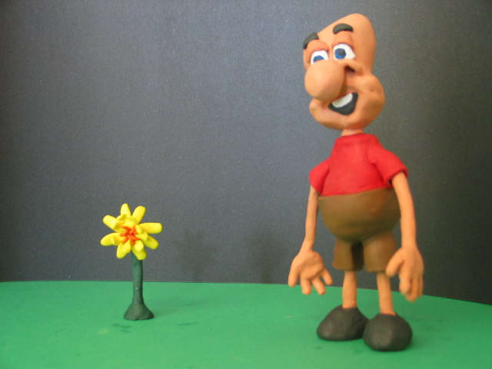
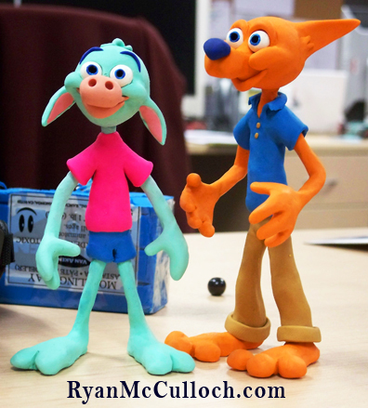
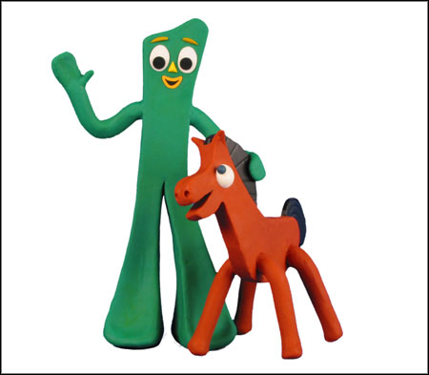
Use Your Imagination!

Slide 24
Persistence of Vision
Refers to brain retaining the image of what eyes see even after the image is no longer visible.
The brain can only process a certain number or images at a time.
Brain can recognize images as separate images if they are viewed at 16 or fewer images per second.

Slide 25
Persistence of Vision
If the pictures appear faster than 16 per second they begin to merge into each other creating the illusion of movement.
Television and movies are usually created at 25 to 30 images per second

Slide 26
How many still images?
12 frames per second (fps)
10 frames per second
2 frames per second

Slide 27
Types of Animation
Historically there are 3 major types of animation:
Hand Drawn Animation
Stop Motion Animation
Computer Animation

Slide 28
Hand Drawn Animation
Done by an artist who draws each character and movement individually
Very time consuming to have to draw, then colour, then photograph each picture
Draw pictures first, then colour them on celluloid, then they take pictures and animate them
Very expensive due to hours of labour involved
Examples: Older Disney Movies i.e. Bambi, Fox and Hound, Cinderella etc.

Slide 29
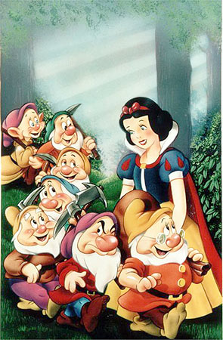
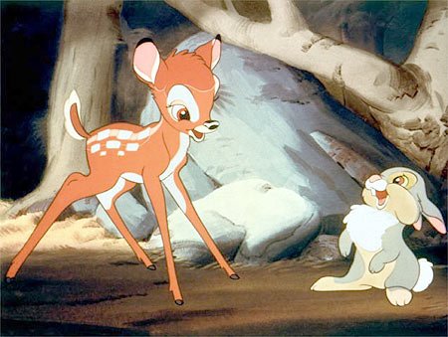
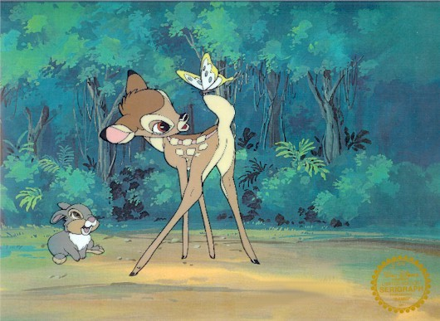
Hand Drawn Animation

Slide 30
Stop Motion Animation
Can be done by virtually anyone, with no extensive training
Does not take that much time relative to the other 2 methods
Uses jointed figures or clay figures that can be moved to make motions
Take still pictures of the individual movements, then use relatively inexpensive computer software to animate

Slide 31
Stop Motion Animation
We use Movie Maker Software to complete our animations
Not very expensive because all you need is a digital camera and the software comes with Windows XP operating system
Examples: Star Wars, Robot Chicken, Old Rudolph the Red Nosed Reindeer

Slide 32
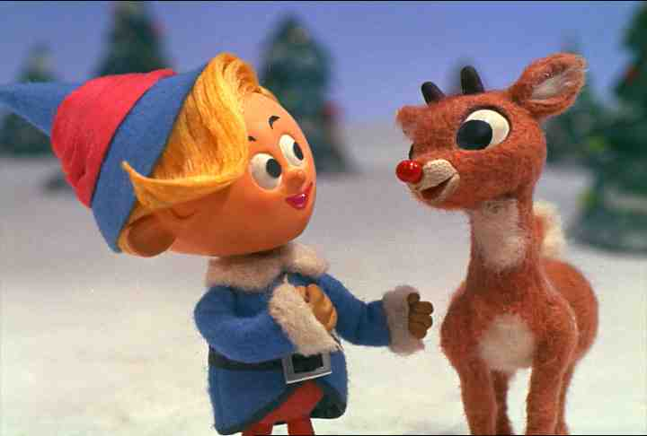
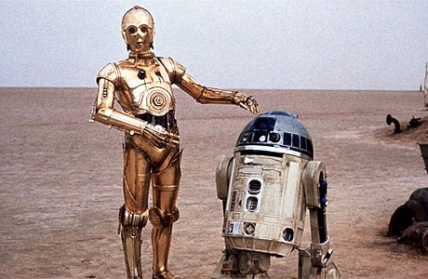
Stop or Model Animation

Slide 33
Computer Animation
All characters and movements are generated using computer animation software
Can also be very time consuming as they can get very complicated in movements and effects
All characters are fully animated with no still pictures

Slide 34
Computer Animation
Can be very expensive because of the complexity of the stunts and animations being done
Huge budgets because the animation sequences more complicated these days eg. the war scenes in Lord of the Rings etc.
Examples: Toy Story, Finding Nemo, Matrix, Lord of the Rings

Slide 35
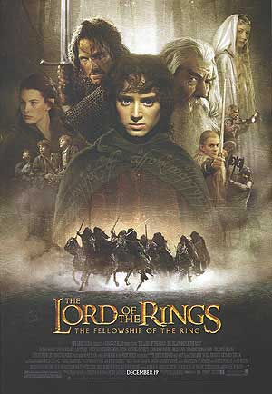
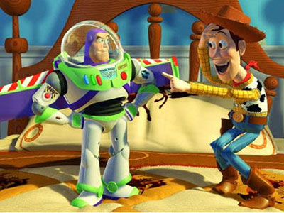
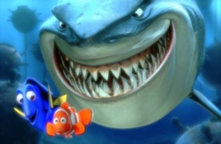
Computer Animation

Slide 36
Animation Storyboards
A storyboard is a series of sketches that can be used as a guide for making a film or video
It contains the action and dialogue of the film
Can also include the music, narration, special effects information etc. for the person to guide them in creating the film

Slide 37
Greatest Impact for Today?
Animation is NOT just for kids
It has become mainstream and kids, teenagers, adults and seniors.
When most teachers today were kids it was very odd for a parent to be sitting with their children and watching an animated show.
Now adults take their kids to the movies and watch with them and there are often “inside jokes” for adults too

Slide 38
Animation uses
Video games
TV Programs (e.g. Weather, News)
Used online (images, ads, chatting)
Simulations (Science & Engineering)
Virtual reality (e.g. second life)

Slide 39
Principles of Animation 1.Squash and Stretch
This action gives the illusion of weight and volume to a character as it moves.
Examples:
A bouncing ball expands on impact
Feet appear longer and flatter when hitting pavement

Slide 40
2. ANTICIPATION
This movement prepares the audience for a major action the character is about to perform such as starting to run, jump or change expression.
Example:
Jumping character would bend knees and swing arms back

Slide 41
3. STAGING
A pose or action that clearly communicates to the audience the attitude, mood, reaction or idea of the character as it relates to the story and continuity of the story line.
Example:
Seeing a character in the distance with their head in their hands sets the stage for a sad mood

Slide 42
4. STRAIGHT AHEAD AND POSE TO POSE ANIMATION
Strategy for developing your animation
Straight ahead animation - start at the first drawing and work drawing to drawing to the end of a scene
Pose to Pose - planned out and charted drawings with key drawings done at intervals throughout the scene. The gaps are filled in.

Slide 43
5. FOLLOW THROUGH AND OVERLAPPING ACTION
Follow Through - when the main body of the character stops all other parts continue to catch up to the main mass
Example:
Arms or long hair move after character has stopped
Overlapping Action - when the character changes direction while his clothes or hair continues forward.
Example:
Bugs Bunny stops turns around, but his legs continue in the opposite direction

Slide 44
6. SLOW-OUT AND SLOW-IN
As action starts, we have more drawings near the starting pose, one or two in the middle, and more drawings near the next pose. Slow-ins and slow-outs soften the action, making it more life-like
Fewer drawings make the action faster
Example:
Old lady driving should take many frames for slow action
More drawings make the action slower.
Example:
Car chase should take few frames for fast action

Slide 45
7. ARCS
All actions, with few exceptions (such as the animation of a mechanical device), follow an arc or slightly circular path
Arcs give animation a more natural action and better flow
Example:
A thrown ball travels in a curve, not a straight line

Slide 46
8. SECONDARY ACTION
This action adds to and enriches the main action
Adds more dimension to the character animation, supplementing and/or re-enforcing the main action.
Example:
Small yawn = small cheek movements
Big yawn = exaggerated arm movements and several facial movements

Slide 47
9. TIMING
The pace of the action
The more drawings between poses, the slower and smoother the action. Fewer drawings make the action faster and crisper.
Expertise in timing comes with experience and experimentation, use the trial and error method.

Slide 48
10. EXAGGERATION
Exaggeration is a caricature of facial features, expressions, poses, attitudes and actions.
Example:
Bugs Bunny sees a girl and his eyes bug out of his head.

Slide 49
11. SOLID DRAWING
The basic principles of drawing form, weight, volume solidity and the illusion of three dimension apply to animation as it does to academic drawing. The way you draw cartoons, you draw in the classical sense, using pencil sketches and drawings for reproduction of life
Example:
Your drawing should be proportionate, head not too large, legs not too long

Slide 50
12. APPEAL
A live performer has charisma. An animated character has appeal. Appealing animation does not mean just being cute and cuddly. All characters have to have appeal whether they are heroic, villainous, comic or cute.
Example:
Ursula in Little Mermaid is a character you love to hate
Ariel is lovable

Slide 51
Animation Languages
Different categories of animation language are:
Linear-list Notation
Each event in the animation is described by starting and ending frame number and an action to be performed
Ex:
40, 53, B, ROTATE “PALM”, 1,30
General Purpose Language
Embedding an animation capability within a general-purpose programming language
Values in the language can be used as parameters to the routine, which perform the animation
Ex:
(grasp my-cube); /* cube becomes the current object
(cw 0.05); /* spin clockwise by a small amount
(grasp ball) /* make ball the cur. object
(right 5) /*move right by 5 units
Graphical languages
Graphical languages provide user the ability to visualize the action clearly
Graphical language describe animation in a more visual way
Can be used for expressing, editing and comprehending simultaneous changes
Examples of the language include: GENESYSTM, S-Dynamics System etc.

Slide 52
Methods of Controlling Animation
Different methods that can be employed to control animation include:
Full Explicit Control
Animator provides a description of everything that occurs in the animation
These specifications may be given by direct manipulation with input devices (mouse, joystick etc.)
Procedural Control
It is based upon the communication of various objects to determine their actions and properties
Constraint-based systems
Many objects move in a manner determined by other objects with which they are in contact
This type of motion can be modeled by constraints
Constraint-based animation system support as hierarchy of constraints and provides motion by the dynamics and structural characteristics of the objects
Tracing Live Action
The trajectory of objects in the course of animation can also be generated by tracking live actions
Live action can be tracked by attaching some sort of indicators to key points on the object
Kinematics and Dynamics
Kinematics refers to the position and the velocity of the object
Dynamics takes into account the physical laws that govern kinematics
Having the knowledge of kinematics of kinematics and dynamics of the object at a point, we can determine the next point in motion

Slide 53
Display of animation
Display of animation can be illustrated with the help of an example.
Let us consider the display of the rotation animation.
Let us assume that the two halves of a picture be image0 and image1
Thus, the rotation can be performed in following steps:
Load look-up table to display the background
Scan-convert object into image0
Load look-up table to display only image0
Do
Scan-convert object into image1
Load look-up table to display only image1
Rotate object data structure description
Scan-convert object into image0
Load look-up table to display only image0
Rotate object data structure description
While (terminating condition)

Slide 54
Transmission of Animation
Transmission of animation over computer networks can be performed using one of the following two approaches:
Method 1
Symbolic representation of animation objects is transmitted together with the operation commands
The transmission time is short because the symbolic representation of an animation object is smaller in size
Method 2
Pixmap representation of the animation object is transmitted and displayed on the receiver side
Transmission takes longer time but display is faster as there is no need for scan-line conversion

